Slide 1
Installation Guide
(JDK – JDK 1.6.0_11)
2008. 12. 11
CODELABOR

Slide 2
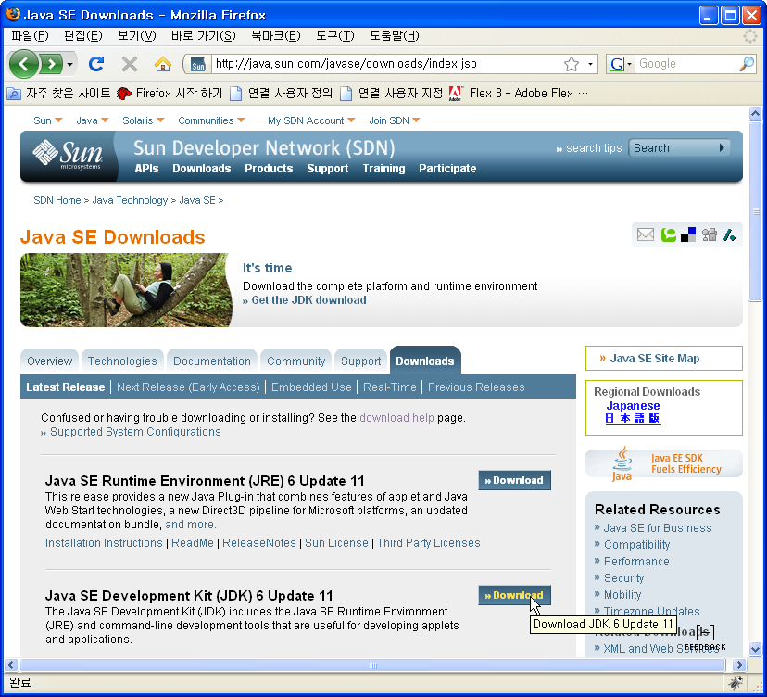
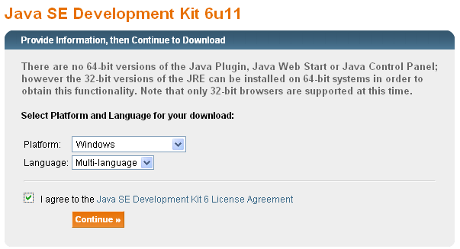
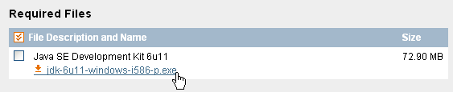
JDK
Installation
Official Site: http://java.sun.com
Download Site URL: http://java.sun.com/javase/downloads/index.jsp
File: jdk-6u11-windows-i586-p.exe

Slide 3

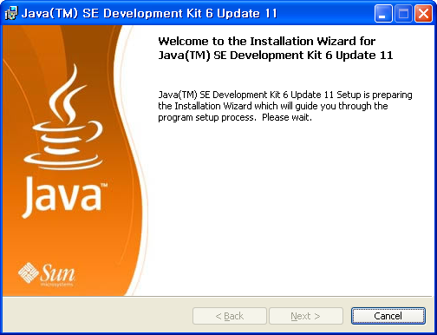
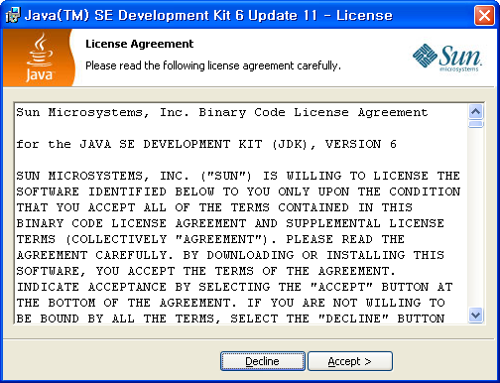
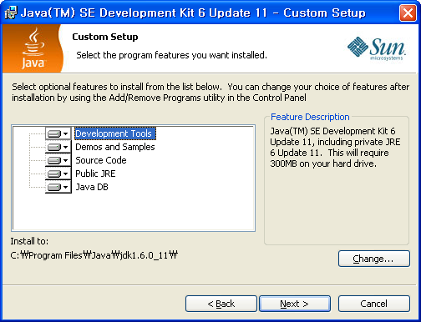
JDK
Installation
Directory
  C:\Program Files\Java\jdk1.6.0_11

Slide 4
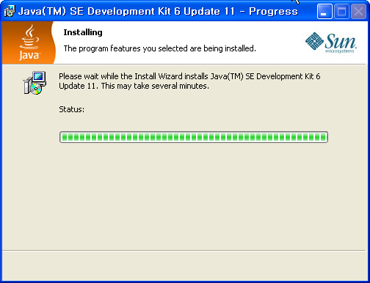
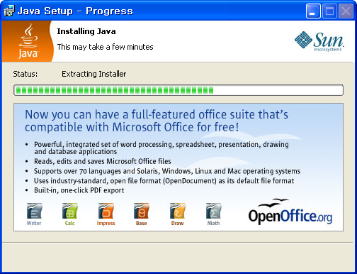
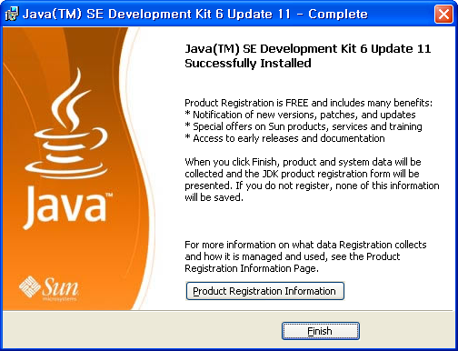
JDK
Installation

Slide 5
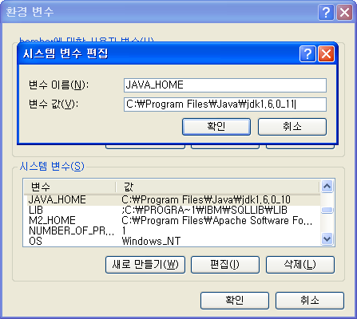
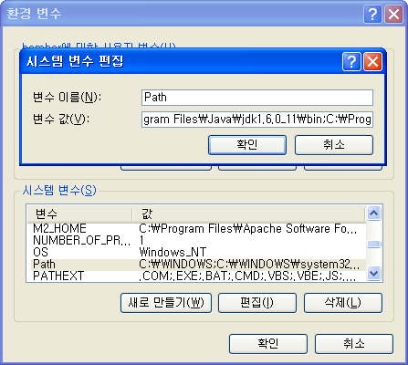
JDK
Configuration
Environment Variable
  Set JAVA_HOME: C:\Program Files\Java\jdk1.6.0_11
  Add PATH: C:\Program Files\Java\jdk1.6.0_11\bin

Slide 6
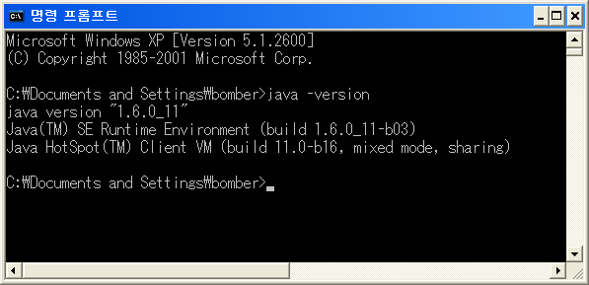
JDK
Version Check
Version
  Execute java –version

Slide 7
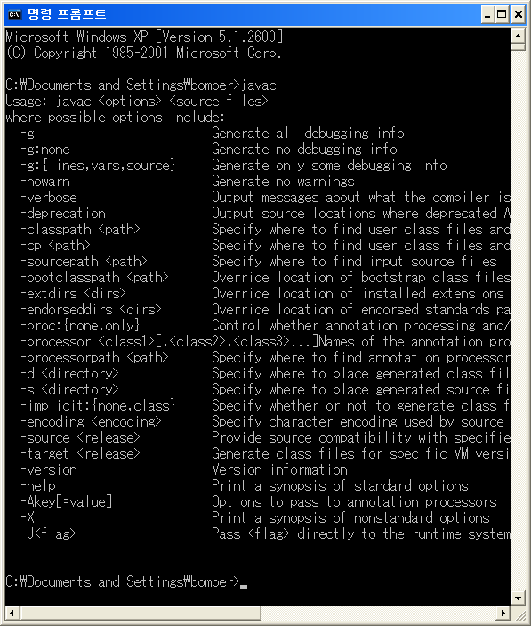
JDK
Path Chech
Path
  Execute javac

